Slide 1

Install and upgrade Cassandra
API Management
Notes:
Welcome to this elearning session about Apache Cassandra.
Cassandra is a key component for APIM so the main goal is to get you bacis skill on this solution
So you are going to learn the key concepts on Cassandra and how to install and operate it.

Slide 3
Understand Cassandra
Know Axway’s best practice for Apache Cassandra performances
Install Apache Cassandra database on a Virtual Machine
Try first CQLH commands
Upgrade Apache Cassandra

Slide 4
Prerequistes

Slide 5
A Linux VM
APIM installer 7.7 release 20210511
A 64-bit OpenJDK JRE or Oracle JRE version 8
The apache Cassandra package v2.2.19
The apache Cassandra package 3.11
https://support.axway.com/en/downloads/download-details/id/1449331
https://openjdk.java.net/install/
https://support.axway.com/en/downloads/download-details/id/1449277
https://support.axway.com/en/downloads/download-details/id/1449279
Notes:
To realize this techlab, you will need a Virtual Machine with your prefered OS.
If you plan to install the Cassandra and APIM on the same VM, I recommend to use a diretly a Centos 8.

Slide 6
Install Cassandra on VM
Cassandra overview
Notes:
Apache Cassandra is the official NoSQL Database used by the APIM solution.
Cassandra store multiple assets created by different components.
The recommended version is v3.11.11 since the APIM 7.7 August release 2021.
The previous version was v2.12.12.
To simplify its installation, the right Cassandra version is provided in API Gateway installer and part of the solution installation options.

Slide 7
What is Cassandra
Node 1
Open Source No SQL Database.
Adapted for High availability
2 importants parameters:
Replication factor: how many nodes contains the data
Consistancy strategy: how many answers is required
Learn more about Apache Cassandra : https://cassandra.apache.org/doc/3.11/cassandra/getting_started/index.html
Node 4
Node 2
Node 3
Notes:
Apache Cassandra is an open source, distributed and decentralized storage system (database), for managing very large amounts of data across many commodity servers.
Classified as a NoSQL database.
simplicity of design
horizontal scaling
finer control over availability
Designed for high performance and high availability
Including multi-datacenter capabilities
No single point of failure

Slide 8
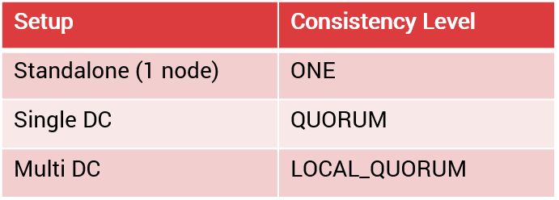
Cassandra for APIM
Data for API Manager.
API Gateway Client registry as API key and Oauth.
Cassandra is optional to store following Data:
Custom KPS table definition and data
Oauth Token stores
3 possible deployment and their impacts impact:
Notes:
Cassandra is the data repository for API Manager configuration, API Manager quotas and default OAuth tokens
Cassandra can be used for Key Property Store (KPS) policy capabilities as well
KPS gives autonomy and flexibility in API Gateway to manage simple data models
API Manager requires modification to be taken in account immediately, on all instances
Capabilities not delivered by API Gateway repository
API Manager architecture often requires multi-datacentre deployment
Regular SQL database is less suited than Cassandra to provide these capabilities.

Slide 9
Security best practices
Use a specific UNIX user account for Cassandra
Synchronise clocks between each Cassandra nodes
Use a Login/password minimally or a mutual authentication per certificate.
Encrypt end to end connection
A monitoring solution using JMX is required.
Notes:
Cassandra User:
This user account must own all Cassandra related files, and it must be used to run the Cassandra process.
Failing to synchronize the clocks will result in:
Faults in data synchronization.
Failure to start or configure the machines correctly.
NTP must be configured.
Here is few examples.
Keep in mind that disk encryption, compression can impact the thep

Slide 10
Performance best practices
Optimize memory allocation with Jemaloc tool (http://jemalloc.net/)
Use SSD disk for lower read latency
Turn swap off
Create small partitions
Adapt sizing of the JVM
Check logs at startup
Disable logging to stdout
Set limit for Cassandra user
Please consult to implement the previous recommendations : https://docs.axway.com/bundle/axway-open-docs/page/docs/cass_admin/cassandra_bestpractices/index.html
A powerful monitoring is required. Many tools provide some solutions
Notes:
Jemaloc tool :
Useful to opmitise memory usage
Comme toute appli java, Cassandra utilise la JVM et donc la Heap pour stocker les objets / instance de classes en mémoire. D'après ce que je peux lire, lorsque le GC se met en pause, ça peut mettre la grouille chez Cassandra en ne purgeant pas ou pas assez rapidement les objets / instances de classe non utilisés. L'utilisation du off-heap permet de stocker des instances hors heap et Jemalloc permet de basculer des instances sur de off-heap et non de les mettre tous dans la Heap (soumise au GC)
[14:32] Olivier Valadier
c'est ce que je comprends
Check logs at startup
Cassandra executes basic performance and tuning checks at startup, and it writes warning messages to the console and to the system log file when issues are found.
Swap off:
Apache Cassandra recommends that swap is disabled.
Disable logging to stdout:
It’s recommended to disable the stdout logging appender because the default Cassandra configuration writes logs to stdout, which adds extra load to the pipe.
Configuration in conf/logback.xml
Set limit for Cassandra user.
Memlock must be unlimited
Nofile 100000
No proc = 32768
LimitAS=Infoinit

Slide 11
Sizing examples
Find one customer with apigateway on multiple DC, volumetry
Find one customer with bigger usage of our apigateway on one DC, High volumetry
With oauth token, kps
Find one customer with smaller usage of our apigateway on one DC, volumetry
Without oauth token, kps
List nb of VM, sizing
List nb of VM, sizing
List nb of VM, sizing
Waiting answer from PSO teams, ACS

Slide 12
Install or upgrade Cassandra on VM
Basic Installation

Slide 13
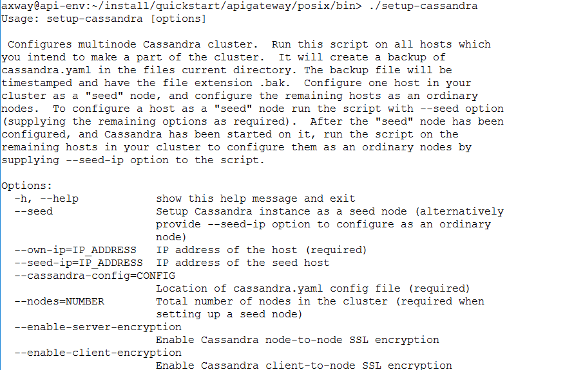
Apim run package: Simple way to install Cassandra
Tools : Apigateway/posix/bin/setup-Cassandra
A helper, not mandatory
Select more examples
Notes:
Axway provide a tool in

Slide 14
Setup-Cassandra : Simple way to configure Cassandra
Tools : Apigateway/posix/bin/setup-Cassandra
A helper, not mandatory
Select more examples
Notes:
Axway provide a tool in

Slide 15
Install or upgrade Cassandra on VM
Basic installation

Slide 16
To show :
Show packages on VM (prerequisites)
Install OpenJDK
Create user, set limits, etc
Install Apache Cassandra in unattended mode
Check that installation is working.

Slide 17
Install or upgrade Cassandra on VM
2. First step with Cassandra

Slide 18
Administrate the cluster
Command : cassandra/bin/nodetool
See more actions on this chapter : https://docs.axway.com/bundle/axway-open-docs/page/docs/cass_admin/cassandra_ops/index.html
Notes:
Utility for Cassandra, to administrate cluster
Used in installation and other admin tasks
Ex:
nodetool repair - Repair one or more tables
nodetool status - Print cluster information (and see everything is working)
There are tools like medusa and reaper to automate nodetool repair and backup/restore

Slide 19
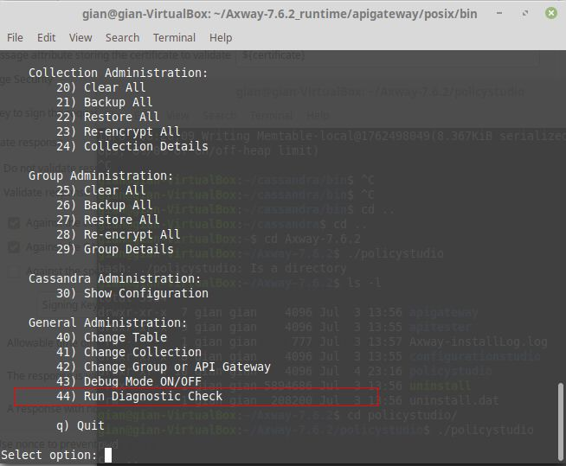
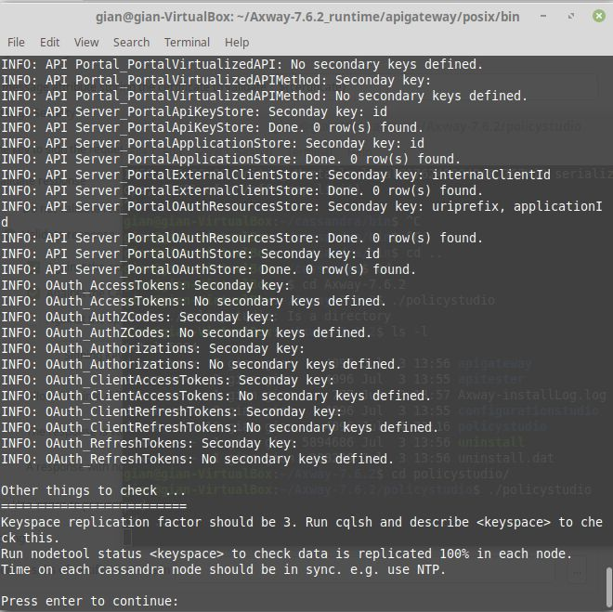
KPS administration capabilities
Provide KPS administration capabilities
Backup
Restore
Data CRUDL
Provide diagnostic capabilites

Slide 20
Language interpreter
Cassandra Query Language (CQL)
cassandra/bin/cqlsh
Examples:
Show tables examples
(to do)
Display rows
Never modify datas manually
Notes:
Cassandra Query Language (CQL)
Similar to SQL syntax

Slide 21
Install or upgrade Cassandra on VM
2. First step with Cassandra
My opinion is Upgrade must be a dedicated subject that regroup other components. (Cassandra, Admin Node Manager, API Gateway, API Manager)

Slide 22
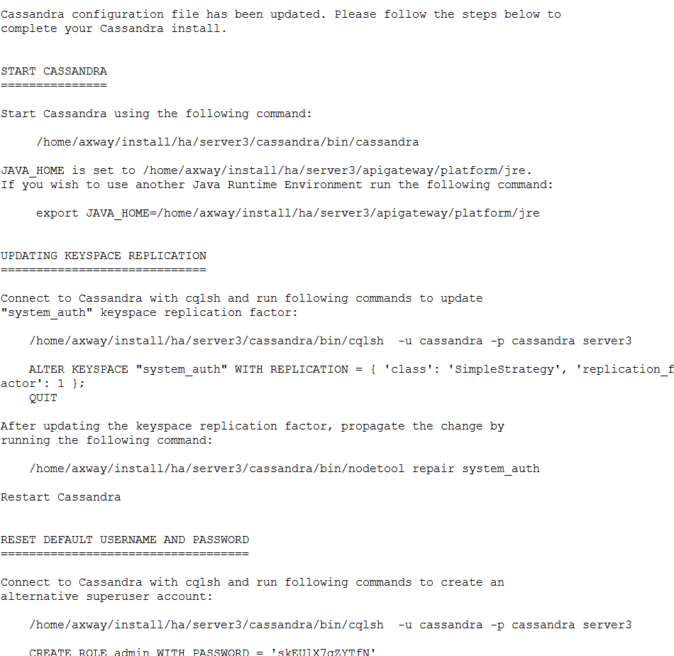
Get useful setup instructions as output
To show :
Start Cassandra
Manage nodes
Populate APIM structures with Axway tool
Try basics query
Stop Cassandra database

Slide 23
Install or upgrade Cassandra on VM
3. Upgrade

Slide 24
How migrate from 2.2.12 to 3.11
Require a middle version for zero downtime in HA.
Recommandation:
No schema changes must be done until the complete upgrade
Upgrade the Cassandra cluster when traffic is lowest
Complete description here : https://docs.axway.com/bundle/axway-open-docs/page/docs/apim_installation/apigw_upgrade/upgrade_cassandra/index.html
2.2.12
2.2.19
3.11

Slide 25
Install or upgrade Cassandra on VM
3. Upgrade

Slide 26
To show :
Backup data
Install Cassandra 3.11
Notes:
This Techlab will be focus to upgrade Cassandra only.
It means that in prerequisite, you must upgrade the APIM platform.

Slide 27

Prerequisites
Key Question: What are the rules of the Knowledge Check?
To be addressed by SME and CA
For each (or all of) the questions:
How many attempts per question (between 1 and Infinite)?
Result of the Quiz:
Validation of the quiz through a score or only by doing it?
What is the % of good answer for validating the entire quiz if needed ?
Do we allow the learner to review the Quiz ?
If he review does the learner see only where he failed or do we show him the good answers ?

Slide 28
Does Axway provide a Cassandra Package
No
Yes

Slide 29
What’s Cassandra version is available for a APIM 7.7 august 2021 release ?
4
2.2.19
3.11
All previous answers

Slide 30
What’s the steps to upgrade Cassandra ?
Save data
Install Cassandra v2.2.19
Migrate data from Cassandra v2.2.12 to v2.2.19
Backup Cassandra data
Install Cassandra v3.11
Migrate data from Cassandra v2.2.19 to v3.13

